Slide 1
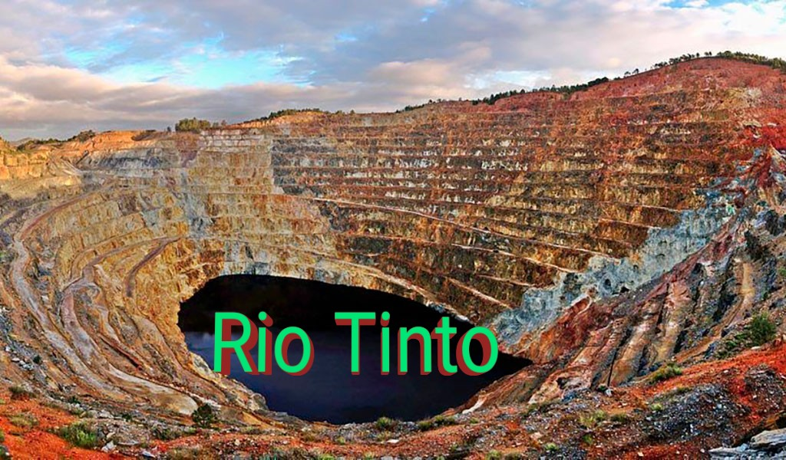
Performance Analysis (2016 – 2020)

Slide 2
Products – Sales Revenue 2020

Slide 3
Strategies
Portfolio
People
Performance
Partner
Portfolio Strengthening
Diversified Workforce
Safety & Operational Excellence
Partnership with traditional owners, technology providers

Slide 4
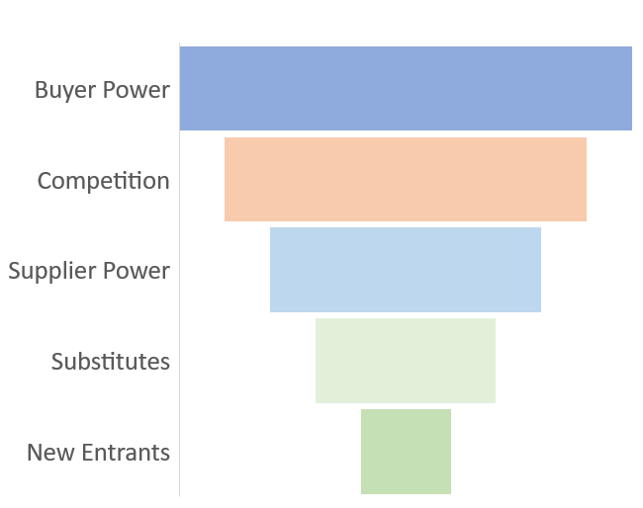
Impact of Porter’s Forces
Having China as the only major consumer market gives the negotiation edge to the buyer
Tough entry barriers in the industry could discourage new entrants.

Slide 5
Uncertainties
Geo Political Trade
Material Risks
Relationship with communities
Living in Corporate Values
Transition to a low carbon future
Strategic Partnerships

Slide 6
Strategy and ESG
Environment
Agreement with partners to address emissions
Social
Bringing the gender diversity
Governance
Strengthening the approach of cultural heritage management
Indigenous leadership

Slide 7
Return on Equity (ROE)
Comprehensive indicator of financial performance.
ROE = Profit or Loss
Shareholder’s Equity
Notes:
ROE is a good starting point when financially analysing a firm. This is because it is an indication of how well a company uses shareholder funds to generate returns.

Slide 8
Profitability Ratios
-BHP
-Fortescue
-Industry Average

Slide 9
Return on Equity (ROE)
Comprehensive indicator of financial performance.
ROE = Profit or Loss
Shareholder’s Equity
Notes:
ROE is a good starting point when financially analysing a firm. This is because it is an indication of how well a company uses shareholder funds to generate returns.

Slide 11
Return On Assets (ROA)
Efficiency at using total assets.

Slide 13
Liquidity Ratios
Quick Ratio<- assumes trade receivables are liquid
Cash Ratio<- only considers cash/cash equivalents.

Slide 15
Efficiency Ratio
Asset turnover – will vary from sector to sector, compare with competitors

Slide 17
Investment Ratios
EPS growth <- the rate at which a firm is growing its profitability. Takes into account dilution from new stock issuance, share repurchases and employee stock stock options

Slide 20
Raising the Capital
Opportunities
Risks
Investment in Large Projects
Resources to Reserves
Commodity Economics – Iron Ore price variation
Access to Capital – Economic Downturn due to uncertainty around

Slide 21
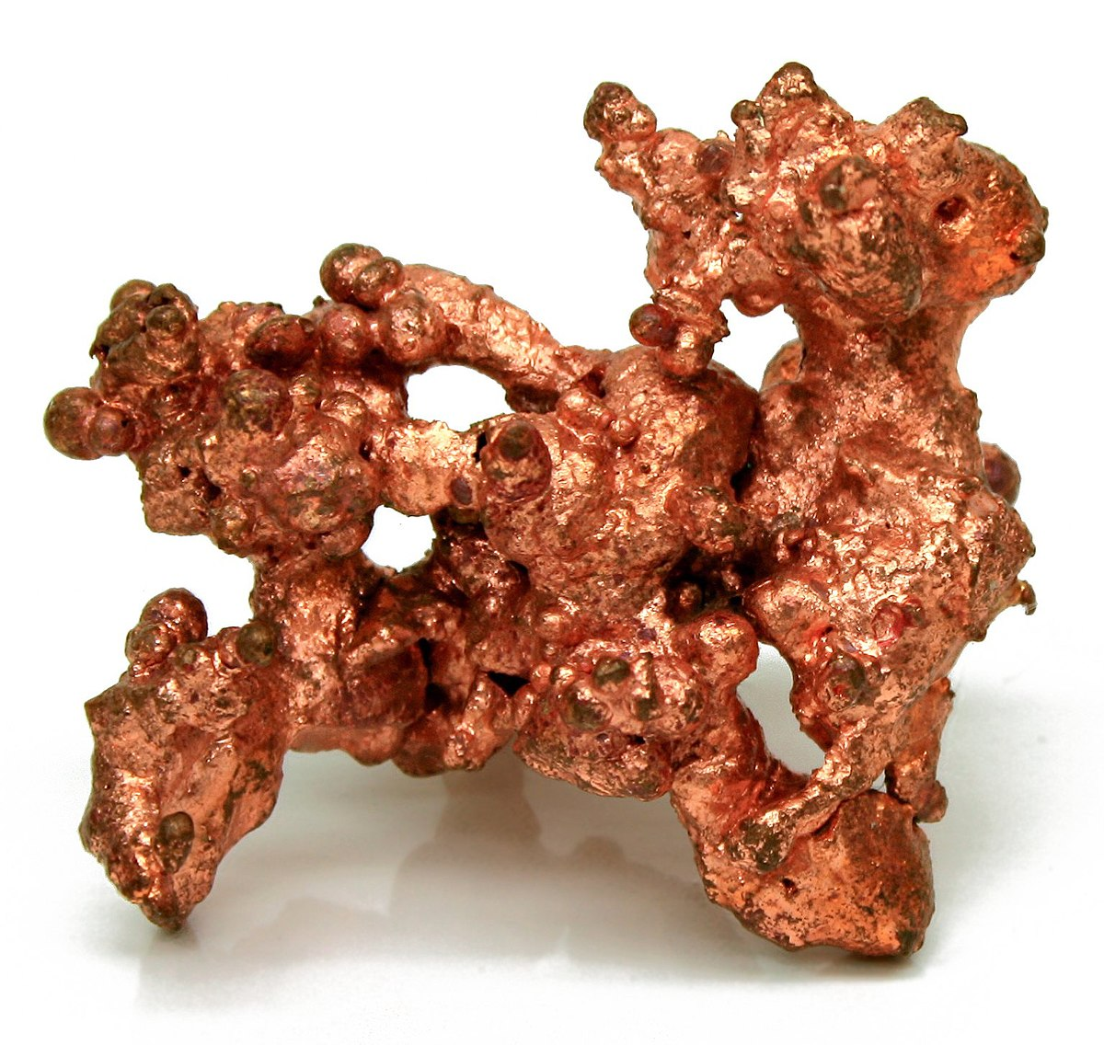
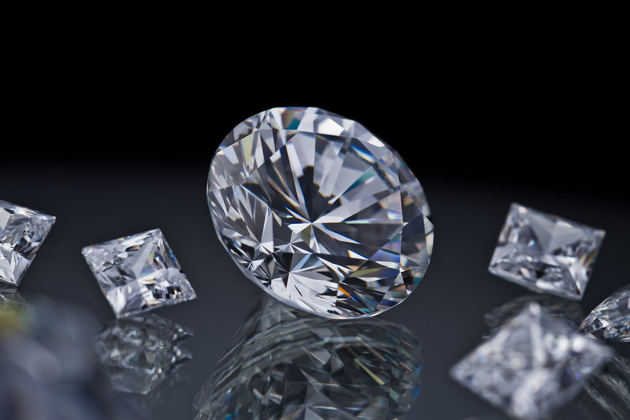
Copper and Diamonds
Gross sales 2020; $5.4 billion
Gross sales 2019: $5.8 billion
Worth approximately 10& of total revenue
Copper is going to become more important in the next few years, per the Annual Report.
This Photo by Unknown author is licensed under CC BY-SA.
This Photo by Unknown author is licensed under CC BY.

Slide 22
Key Performance Indicators
Total Shareholder Returns (TSR) - 110.1%
Return on Capital Employed (ROCE) - 27%. This has been steadily increasing since 2016.
Debt decreased by almost $3 billion.
Total employees has decreased in recent years, whilst overall female representation has remained stagnant.
 | 2016 | 2017 | 2018 | 2019 | 2020
Revenue ($bn) | 33.781 | 40.030 | 40.522 | 43.165 | 44.611
Sales per employees ($) | 662,138.85 | 855,213.96 | 853,849.72 | 938,226.79 | 939,693.31
Total workforce | 51,018 | 46,807 | 47,469 | 46,007 | 47,474

Slide 23

Environmental
Scope 1 and 2 greenhouse gas emissions remained the same to the previous year.
No climate-based goals have been allocated to the Long-term Incentive Plan (LTIP)
This Photo by Unknown author is licensed under CC BY-NC.

Slide 24

Social
Women in positions of leadership increased to 26.1%, although overall employment percentages did not increase.
Successful implementation of Covid-19 protective measures.
This Photo by Unknown author is licensed under CC BY-NC-ND.

Slide 25

Governmental
Objectives became somewhat merged with Social aspects; Group Communities and Social Performance improvements.
Hard to quantify success in this aspect of the business, due to the vagueness of reporting.
This Photo by Unknown author is licensed under CC BY-SA.

Slide 26

Accounting Standards
Inaccuracies relate to 2004 merger with Consolidated Zinc..
Information reported and presented legally, albeit not entirely truthfully.
All in accordance with IFRS Accounting Standards
This Photo by Unknown author is licensed under CC BY-SA.

